Slide 1
Front End Task
Mahmoud Alfaham

Slide 2
Section 1: Screen shots Demonstration

Slide 3
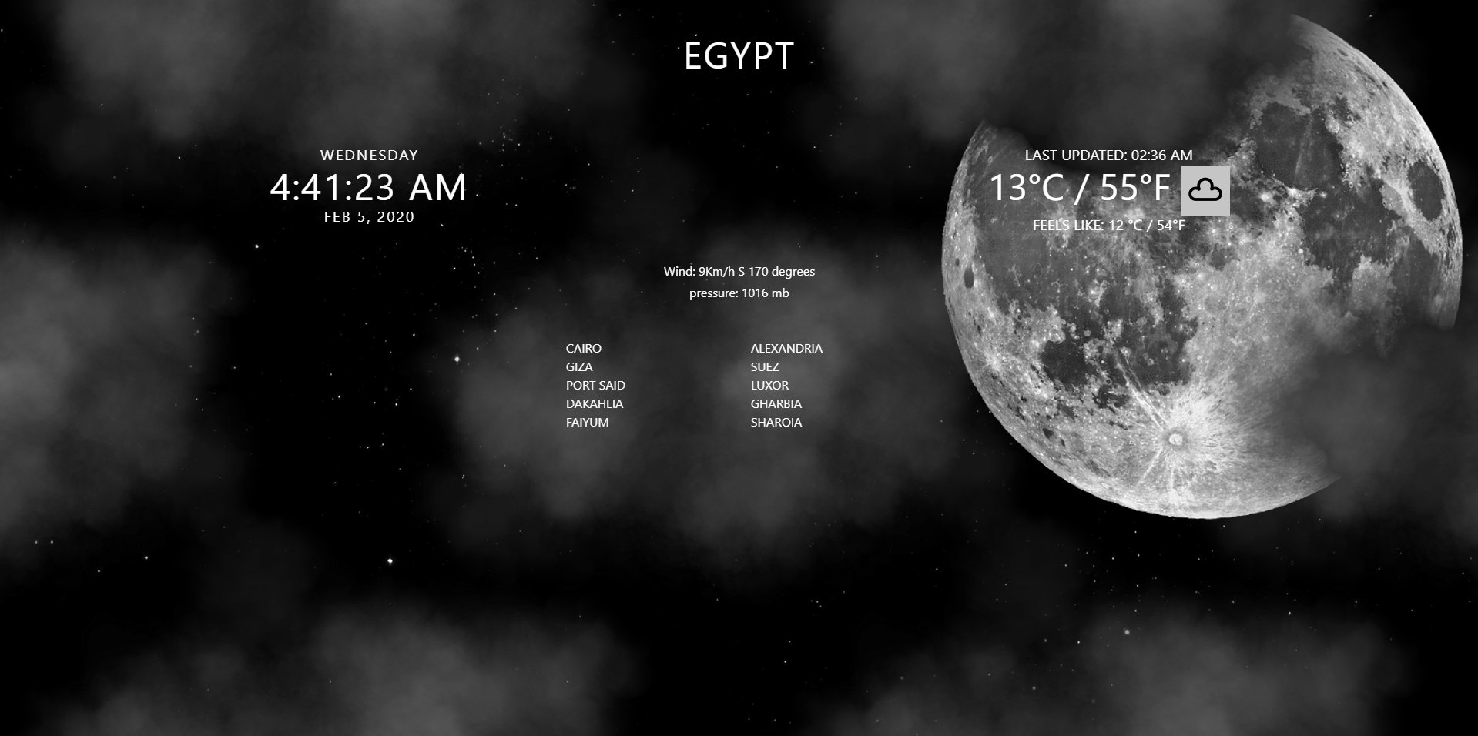
Home Page (country)

Slide 4
Home Page (country) : Finished Features
0
1
2
3
0) Got animated CSS design
as background that should change
during day or night (wasn’t done)
1)
a)First used JS to get lat and lng but
It was not accurate all the time It gave coords in Alex while I was in Cairo ;)
b) I used Api that get the coords using the IP address
2) made a clock using Date
3) got current weather using the worldWeatherOnline
4) Didn’t Find Api So I used dummy data in case of Egypt or USA and when link clicked should move to the city page
3
4

Slide 5
Home Page (country) : Delayed Features
0
1
2
3
0) add day theme and make the night theme bg darker to make the white text clearer
1) add search field
2) ability to change to 24hrs format , make the
clock in separate component to be reused
3) show country historical weather ,add my own images with transparent bg
4) Get Data from api
More stuff:
1- Celsius and Fren switcher
2- add wind direction arrow
3- add UI for pressure
4

Slide 6
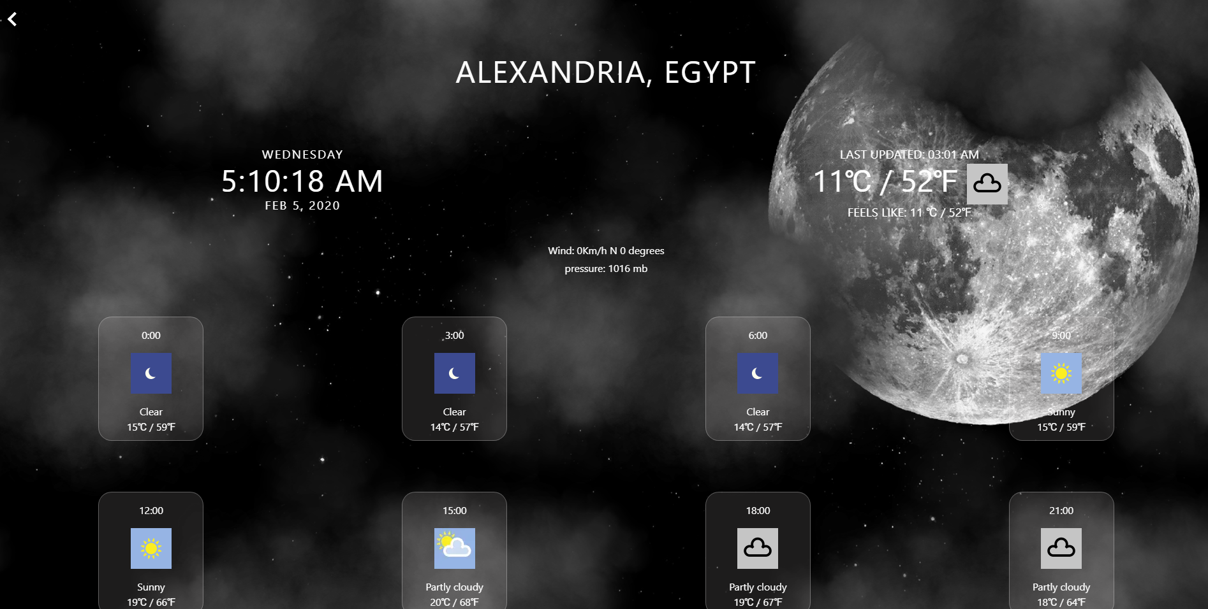
City

Slide 7
City : Finished Features
0
1
0) Back btn to the country page
1) City sent in the url (weather/:city)
2)
The card contains the time and the its
Basic info like temp and time and img
The card changes color on hover
Delayed Feature : active card using the current time
2

Slide 8
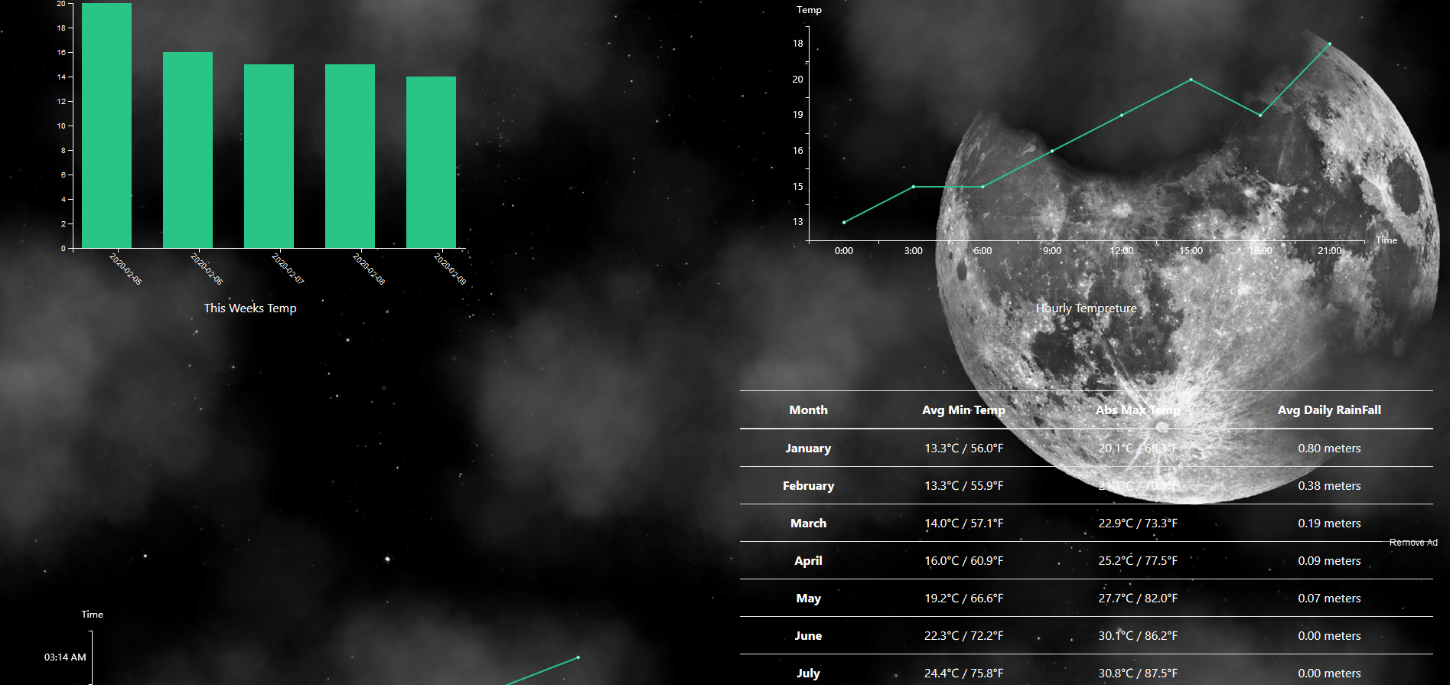
City (part 2: Graphs)

Slide 9
City (part 2: Graphs): Finished Features
0
1
0) Created a reusable d3 Component using d3 vanilla JS and put it in Angular module that can be imported anywhere in the app
1) using eCharts I create line chart in charts module that can be imported and reused
2) Simple table with month avg data
Modifications:
0) Find a fix for the chart needs refresh after screen width modified
2

Slide 10
Section 2: Code
I used:
Angular 2
Lazy loading (weather module)
D3 (D3 module) and ECharts (prebuilt-charts module)
Exported Self Contained Modules (D3 module and prebuilt-charts module)
SCSS
Unit testing (helper service and other)
Adobe XD

Slide 11
Section 3: Things didn’t have time to do
Draggable and resizable components (Tried angular gridster2 but couldn’t finish it in time)
Fully unit test the app
E2E testing

Slide 12
Thank you for your time

